Slide 1
AKASH DANEY A G
Image Generation using GANs

Slide 2
Image Generation using GANs

Slide 3


AGENDA 1. Problem Statement 2. Project Overview 3. End Users
4. Solution & Proposition
5. The WOW in the Solution 6. Modelling 7. Output & Result
3/21/2024 Annual Review

Slide 4

PROBLEM STATEMENT
The aim of this project is to develop a system for image generation using Generative Adversarial Networks (GANs). The goal is to explore and implement advanced deep learning techniques to generate high-quality, realistic images from random noise or seed images.
Research and Understanding, Data Collection and Preprocessing, Model Implementation, Training and Optimization, Evaluation and Validation are a few objectives of GANs.

Slide 5

PROJECT OVERVIEW
The project "Image Generation using GAN" focuses on leveraging Generative Adversarial Networks (GANs) to create high-quality and diverse images from random noise or seed images.
GANs are a type of deep learning architecture consisting of two neural networks, the generator and the discriminator, which compete against each other to improve the quality of generated images.
The primary objective of this project is to implement and evaluate various GAN architectures for image generation. By harnessing the power of deep learning, the project aims to generate realistic and novel images that can find applications in computer graphics, data augmentation, and creative arts.

Slide 6

WHO ARE THE END USERS?
The end users of the "Image Generation using GAN" project can vary depending on the specific applications and use cases targeted by the generated images.
Data Scientists and Machine Learning Researchers
Content Creators and Media Professionals
Academic and Research Communities
Artists and Designers
General Public

Slide 7

YOUR SOLUTION AND ITS VALUE PROPOSITION
Integration: Provide an easy-to-use API or library interface for integrating the image generation functionality into other applications or systems.
Functionality: Implement different modes for image generation, such as random noise input, conditional generation based on specific attributes, or interpolation between seed images.
User Interaction: Develop a user-friendly graphical user interface (GUI) or web interface for interacting with the image generation system. This can include options for tweaking parameters, selecting generation modes, and visualizing outputs.
Customization: Allow users to customize GAN model configurations, hyperparameters, and training settings based on their specific needs and constraints.

Slide 8

THE WOW IN YOUR SOLUTION
Generator : The generator network takes random noise (often drawn from a simple distribution like Gaussian) as input and learns to generate fake data (e.g., images) that resembles the real data.
Discriminator : The discriminator network acts as a binary classifier that distinguishes between real data (e.g., real images from a dataset) and fake data (images generated by the generator). It is trained to output high values for real data and low values for fake data.
Loss Functions : The generator and discriminator are optimized using different loss functions. The discriminator's loss function is typically a binary cross-entropy loss, whereas the generator's loss function is often the inverse of the discriminator's loss.
3/21/2024 Annual Review

Slide 9
Convergence and Training Dynamics : GANs are notoriously challenging to train due to their adversarial nature. Training GANs requires careful tuning of hyperparameters, monitoring of loss functions, and dealing with issues like mode collapse (where the generator only learns to produce a limited set of outputs) or instability.
Adversarial Training : The key idea behind GANs is to train the generator and discriminator networks simultaneously in a competitive setting. The generator's goal is to fool the discriminator into classifying its fake data as real, while the discriminator's goal is to correctly distinguish between real and fake data.
3/21/2024 Annual Review

Slide 10
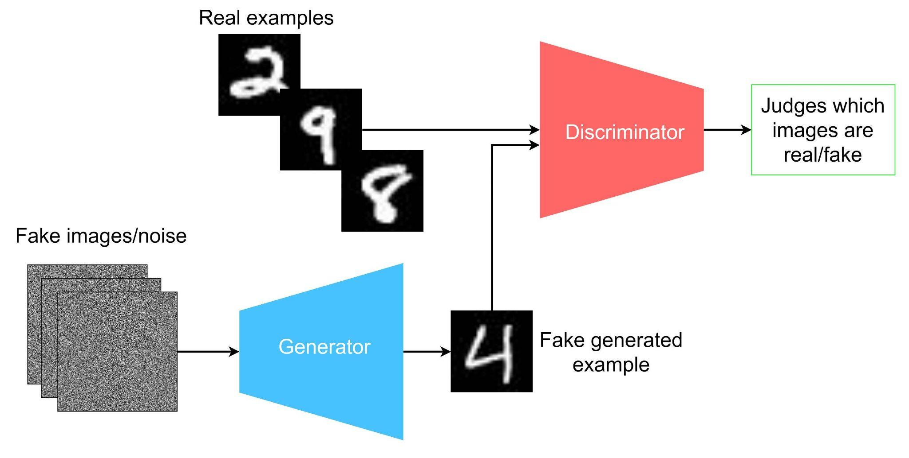
MODELLING

Slide 11
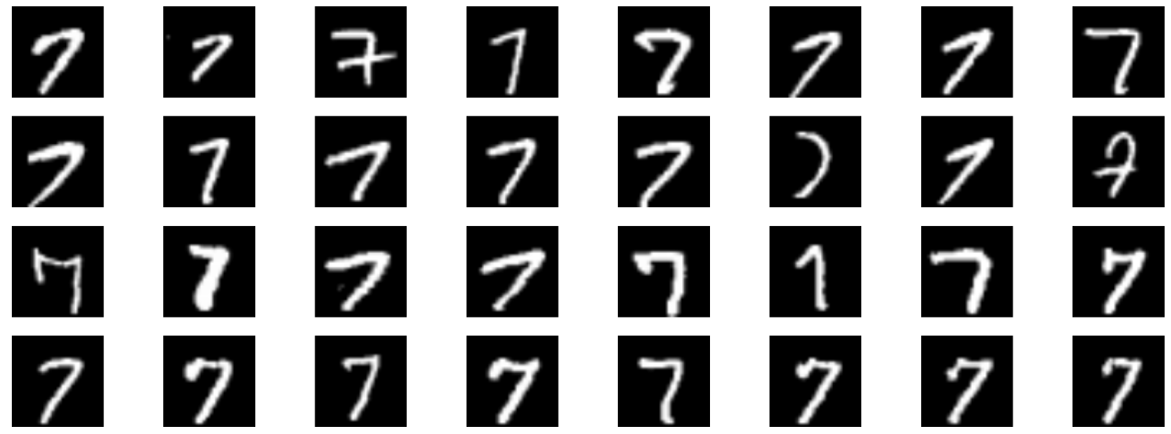
OUTPUT:

Slide 12
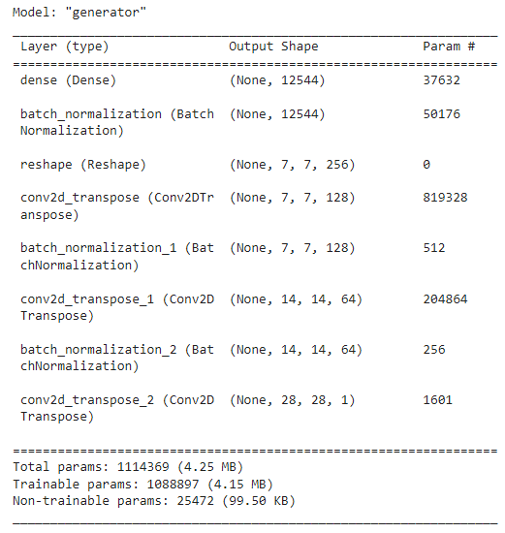
OUTPUT:

Slide 13
RESULTS:
In conclusion, the project on "Image Generation using GAN" has explored the capabilities and applications of Generative Adversarial Networks (GANs) in the context of creating synthetic images.
Throughout this project, we have achieved several key milestones and gained valuable insights into the field of deep learning and computer vision.

